Slide 1


University of Khartoum
Faculty of Science
Department of Zoology
Multiplicity of Plasmodium falciparum infection using Merozoite Surface Protein 2 Gene in Khartoum
By
Ghada Yousif Mohammed Yousif
Dr.Hind Mohamed Abushama
Symposium on: Advances in Parasitology “Education and Research in Parasitology in the service of Mankind “

Slide 2

INTRODUCTION AND LITERATURE REVIEW
Malaria in Sudan: In Sudan, malaria causes nearly 7.5-10 million cases and 35,000 deaths every year (Himeidan et al., 2005)
Merozoite surface protein 2 Gene: the MSP2 gene, codes for a merozoite surface polymorphic glycoprotein (Kiwuwa et al., 2012). The analysis of MSP2 alleles involves two major allelic families, FC27 and 3D7. The MSP2 gene is also the basis of determining the multiplicity of infections (MOI) in infected individuals (Koukouikila-Koussounda et al., 2012).

Slide 3
Objectives
1- To find out the allelic frequency of FC27 and 3D7 in P.falciparum isolates from Khartoum.
2- To measure the multiplicity of infection of P.falciparum using MSP2 gene.
3- To investigate the association between MOI of P.falciparum, age, gender and parasite density.

Slide 4
Rationale
Malaria remains endemic in the tropics and sub-tropics including sub Saharan Africa. It is an important cause of death among Sudanese. The resistance to antimalarial drugs is now a serious problem.
Malaria vaccine is considered as an additional necessity. However, genetic diversity in Plasmodium falciparum is a major limitation for the development of an effective malaria vaccine. It is necessary to study the parasite population to which people are actually exposed.
The Merozoite Surface Protein 2 (MSP2) of P.falciparum is considered a good candidate for inclusion into a malaria vaccine. This study provides an estimate for the genetic diversity and multiplicity of Plasmodium falciparum in Khartoum.

Slide 5
MATERIALS AND METHODS
Study design and Study population: This was a cross-sectional, hospital based study conducted in Khartoum,57 study participants were enrolled.
Scientific & Ethical considerations: scientifically reviewed and passed by the Health Research Ethics Committee of the Health Research Council, National Ministry of Health. The study participants were asked for their informed consent.
Sample collection and preparation Two and a half mls of venous blood in EDTA were collected from study participants.
Microscopical examinations:
Thin and thick blood films
Staining techniques
Malaria parasite count
Number of parasites per 200 leukocytes × Total WBCs count / 200 WBCs
DNA extraction: DNA was extracted using chloroform - ethanol method (Vasuki et al., 2001)

Slide 6
MATERIALS AND METHODS
MSP2 genotyping Two pairs of primers, an outer pair and a nested pair, were used in order to increase the sensitivity (Snounou et al., 1993)
PCR condition and amplification program: Ojurongbe et al., 2011.
Agarose gel electrophoresis
Multiplicity of infection (MOI) Multiplicity of infection (MOI) is a measure of the number of different P. falciparum strains that infect one individual. MOI is assessed by genotyping of polymorphic marker genes (Kobbe et al., 2006).
Statistical analysis :Data were analyzed using SPSS version 16.5. The frequency of alleles. Chi-square test was used to compare between MOI against age, gender, and parasite density. The One-way analysis of variance (ANOVA) was used to compare mean parasite density between age groups. Differences were considered statistically significant at P values < 0.05.

Slide 7
RESULTS
Parasitological indexes and demographic data:
SD = Standard deviation, PD = Parasite density
Table 1: Age, gender and parasite density of study participants.
A total number of 57 study participants were recruited in this study. According to microscopy, 50 (87.7%) samples were identified as P.falciparum and 7 (12.3%) samples were identified as P.vivax.
Characteristics
Age (Mean ±SD) 31.38 ± 21.2 Age range (years) 4 -74 Male: female 1.6 : 1 PD (Mean ±SD) 13400 ± 17000 PD range (parasite/µl) 38–69280

Slide 8
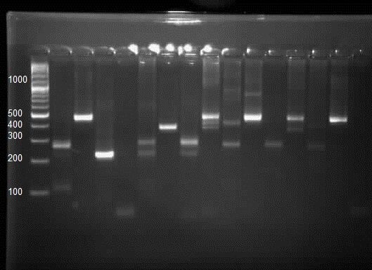
Figure 1 PCR genotyping for 7 samples (001-007) using MSP2 alleles (FC27) and (3D7)
Molecular weight marker (MW) 100 bp ladder.
Lane 1, 3, 5, 7, 9, 11, 13: (3D7)
Lane 2, 4, 6, 8, 10, 12, 14: (FC27)
Lane 15: negative control
Merozoite surface protein 2 allelic distribution:
Base pair size variation of FC27 and 3D7 alleles: A total of 19 different alleles were identified. Ten different alleles obtained for FC27 ranging from 250 to 800 base pair and 9 3D7 alleles, ranging from 200 to 800 base pair
MW 1 2 3 4 5 6 7 8 9 10 11 12 13 14 15
001 002 003 004 005 006 007

Slide 9
Figure 2: Distribution of multiplicity of P.Falciparum infections.
Multiplicity of P. falciparum infections:
The mean multiplicity of infection (MOI) which is the number of alleles per study participant successfully amplified was found to be 3.74
In this study, two (4%) of the study participants had shown single MSP2 family allele, and 48 (96%) had shown multiple alleles.

Slide 10
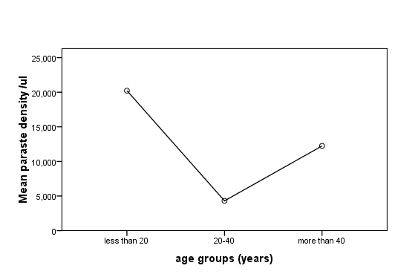
Figure 3: Mean parasite density of P. falciparum infection per microliter blood according to age groups.
Parasite density was categorized by age (figure 3). One-way analysis of variance (ANOVA) was used to compare mean parasite density between age groups and it was found to be significant with P value < 0.05 (0.021).

Slide 11
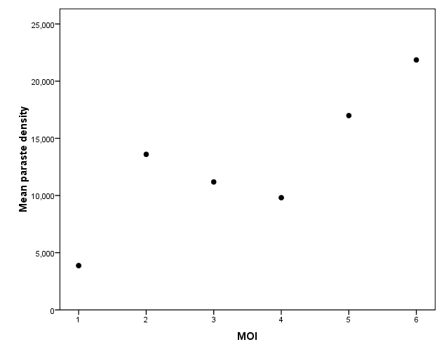
Figure 4: Correlation between the mean parasite density and multiplicity of P. falciparum infection (Spearman rank coefficient = 0.266, P = 0.062).
The mean parasite density was correlated with multiplicity of P.falciparum infection. A positive correlation was found between P.falciparum parasite density and MOI (Spearman rank coefficient = 0.266, P = 0.062) but it was not statistically significant (Figure 4).

Slide 12
DISCUSSION
The current study provides an estimate for the genetic diversity of P.falciparum in Khartoum. MSP2 gene has been used as a marker to test for the multiplicity infection .
Increasing the knowledge of the genetic diversity of P.falciparum may enhance our understanding of the pathological mechanisms of malaria, the processes of acquired immunity, the spread and genetic background of drug resistance and transmission conditions (Ojurongbe et al., 2011).
In this study, the mean parasite density was found to be higher than previous studies conducted at Medani (Haggaz et al., 2014) and Kosti (Abdel Hamid et al., 2013). Higher mean parasite density was obtained in study among children in Nigeria (Ojurongbe et al., 2011).
More different alleles were identified, compared to Ojurongbe et al (2011), Abdel Hamid et al (2013) and Ali et al (2013). This number of different alleles obtained in this study reflects the diversity of the P.falciparum in Khartoum, this might be to the heterogeneity of the study participants involved in this study and there is more chance of introducing new clones to population in Khartoum.
.

Slide 13
DISCUSSION
This study estimated a mean multiplicity of infection of 3.74. The percent of multiple alleles was higher than previous studies (Ojurongbe et al., 2011, Koukouikila-Koussounda et al., 2011, Mayengue et al., 2011, Atroosh et al., 2011, Ghanchi et al., 2010 and Abdel Hamid et al., 2013). Higher MOI was reported in Sennar, in a study done in 2 groups of uncomplicated malaria (4.0) and sever malaria (5.5), with a maximum of 5 clones per patient (Ali et al., 2013).
The multiplicity of infection appeared to decrease with age indicating the development of protective immunity, but the association was not statistically significant. Similar findings obtained by Ojurongbe et al (2011), Mayengue et al (2011), and Koukouikila-Koussounda et al (2011). In contrast Abdel Hamid et al (2013) found a significant association between age and MOI suggesting a key role of adaptive immunity.
Previous studies suggested that the effect of age on the multiplicity of infection is highly affected by the endemicity of malaria. This is mostly a reflection of the development of anti-parasite specific immunity. Thus, in a holo- or hyperendemic area, immunity develops faster and at a younger age than in areas with less intense transmission (Ojurongbe et al., 2011).

Slide 14
The MOI was founded to be independent of gender in the study participants of this study.
In the current study, mean parasite density in age groups was found to be significant with P value < 0.05 (0.021). It was founded to be higher in age group <20 and >40 years and lowest in the age group 20-40 years, this might be explained by the lack of adaptive immunity in younger and the lower immunity in old age (figure .3) .
This study showed a positive correlation between parasite density and MOI (Spearman rank coefficient = 0.266, P = 0.062). A significant positive correlation was reported in Kosti, Sudan (Spearman rank coefficient = 0.470; P = 0.009). (Abdel Hamid et al., 2013). In contrast other studies showed that MOI was not dependent on parasite density or age (Ojurongbe et al., 2011, Ghanchi et al., 2010, and Jelnek et al., 1999
The diversity of a P.falciparum infection at a particular point in time is indeed, a result of many factors, including the genetic repertoire of the circulating parasite population in an area, the number of clones transmitted in single mosquito bites, the accumulation of repeated infections, the clinical status of the host, recent intake of antimalarial drugs and the degree of host immunity. In addition to the various biological factors, the number of detected clones is affected by parasite density and the sensitivity and variability of the genotyping assay (Farnard, 2008).

Slide 15
CONCLUSION
Conclusions:
The genetic diversity of malaria parasite isolates obtained from Khartoum was founded to be very diverse and consisted mainly of multiple clones.
The multiplicity of infections was parasite density dependent but not age or gender in the study participants. There was a positive correlation between MOI and parasite density in this study.
Recommendations:
• It is recommended to collect a larger sample size in order to get better knowledge about the MOI of P.falciparum in Khartoum.
• Collect ethnic and clinical data for our study participants.
• We could include more markers in combination with MSP2 such as MSP1 and GLURP genes and also use genetic markers related to antimalarial drug resistance to gain insight on P.falciparum molecular epidemiology in Sudan
• Evaluate the effect of multiple clones in the absence of adaptive immunity by estimating the MOI in children.
• The use of more advance techniques such as DNA sequencing are necessary to study in depth the molecular structure of the Plasmodium parasite.

Slide 16
Thank You ☺

