Slide 1


AL-NEELIN UNIVERSITY FACULTY OF MEDICAL LABORATORY SCIENCES
Paleoparasitology
PRESENTED BY:
EL-FARABI IBRAHIM MOSTAFA
BSC , MSC (STUDENT)
Symposium on: Advances in Parasitology “Education and Research in Parasitology in the service of Mankind “
28 MARCH 2015

Slide 2
Paleoparasitology is the study of parasite their interaction with host and vectors, from the past.
Paleoparasitology can also be defined as the study of parasite in archaeological material.
Paleoparasitology is a subfield of paleontology –the study of living organism from the past.

Slide 3

Luiz Fernando Ferrira. Named The Search For Parasite In Ancient Material As Paleoparasitology

Slide 4

Bouchet 1995.Recovery Of Helminth Eggs From Archeological Excavations Of The Grand Louvre

Slide 5
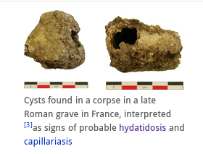
Source Of Material
Cysts Found In A Corpse In A Late Romane Grave

Slide 6
The Primary Source
1.mummified tissues.
2.coprolites . from mammals.
3.fossils.
4.amber inculation.
5.hair.
6.skin.
7.feathers.
8.ectoparasite .
9.ancient thebe's.
10.museum specimens.

Slide 7
Plant and animal parasites have been found in samples from a broad spectrum of geological periods including.
Holocene (sample over 10000 years old).
Pleistocene(over 550000 years old).
Eocene (over 44 million years old).
Cretaceous (over 100 million years old).
Cambrian (over 500 million years old).

Slide 8
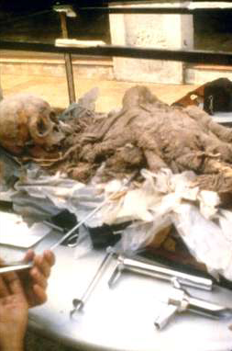
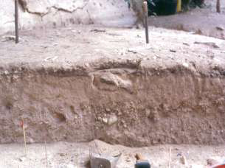
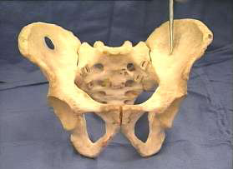
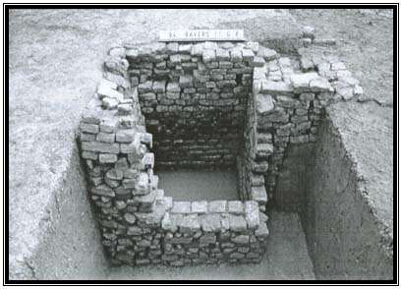

Slide 9
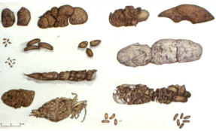
Morphological Patterns Help To Establish The Zoological Origin Of The Coprolites Found In Each Archaeological Region Morphology.

Slide 10
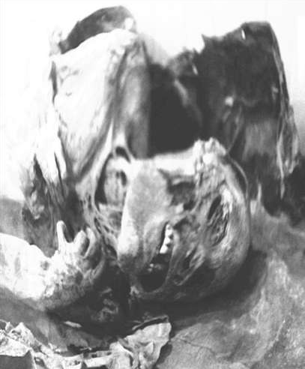
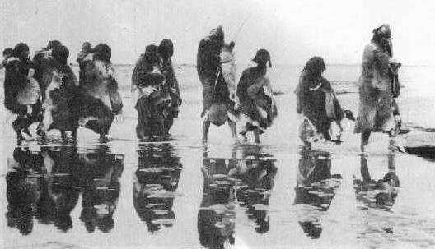
Origin:
Sediments
Skeleton Remains.
Shell-Midden.
Soil occupied By Ancient Human Groups.
Coprolites.

Slide 11

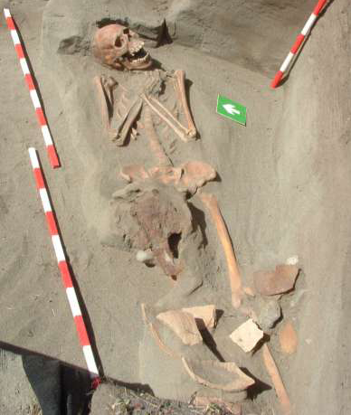
The paleoepidemiological transition after the
contact included social, cultural, environmental and biological changes for Native Americans
Paleoparasitological results showed clearly the difference between the number of intestinal helminthe eggs in coprolites

Slide 12
Summary Of Studies On P.falciparum
Results | Method | Period | Origin
7/18 | Electronic microscope | Hellenistic | Arab persian gulf
34/80 | Immunoenzymatic assay | 5200-1450 BP | Egyptian and nubian mummies
4/16 | DNA | 1550-1324 BC | Acient egyptian mummies

Slide 13
Knowledge Gained From Ancient Animal And Plant Parasite
Studies of parasite remains and traces from the past have yielded vast catalog of ancient host parasite associations .
Genetic sequence data obtained directly from ancient animal parasites and interferences of past relationships based on genetic sequence of existing parasite groups are also being applied to paleoparasitological questions.

Slide 14
Data Obtained By All Of These Methods Are Constantly In Proving
1.Understanding of the origin
2.Evoluation of the parasites themselves.
3.Vector.
4.Host parasite.
5.Vector parasite association.

Slide 15
Protozoal Infection In Ancient Materiales
Helminthes are the most common parasite in archaeological material. Eggs and larvae can be well preserved by desiccation or at times even by mineralization even before the use of rehydration technique parasite egg were found in archaeological material.

Slide 16
Protozoan infection are not easily to identify in archeological remains. Entamoeba coli cyste were recorded in the intestinal contents of peruvian mummy and protozoan cyst were detected in human coprolites dated 1800BP(befor present).eimeria cyste were found in deer coprolites dated 9000 BP from brazil.

Slide 17
Tissue protozoan infection wear even more difficult to diagnosis .small ceramic statuses found in per Columbian burial sites suggested cutaneous leishmaniasis lesions. And histological examination of mummified bodies showed lesion identified as chagas disease. Trypanosoma cruzi was found using electron microscopy.
And diagnosis was conferred by histochemical technique in peruvian mummy

Slide 18
Summary Of Studies On Leishmania spp In Ancient Human Remains
Results | Method | Period | Origin | Protozoan
5/241 | immunohistology | 800 BC | peru | Leishmania spp
4/91 | DNA | 3500-500 AD | Egyptian mummies | Leishmania donovani
1/1 | DNA | 1522-1562 AD | italy | Leishmania infantum
Others parsite :
Giardia duodenalis
Entamoeba spp
i.beli

Slide 19
Molecular Biology Ancient Parasite (DNA)
Diagnosis
Prevention
Treatment
The probe based on nucleic acid for the detection of molecule of DNA to detect specific sequences of parasite DNA or RNA.
Hyperdization: the first technique used to recover DNA from archaeological material.

Slide 20
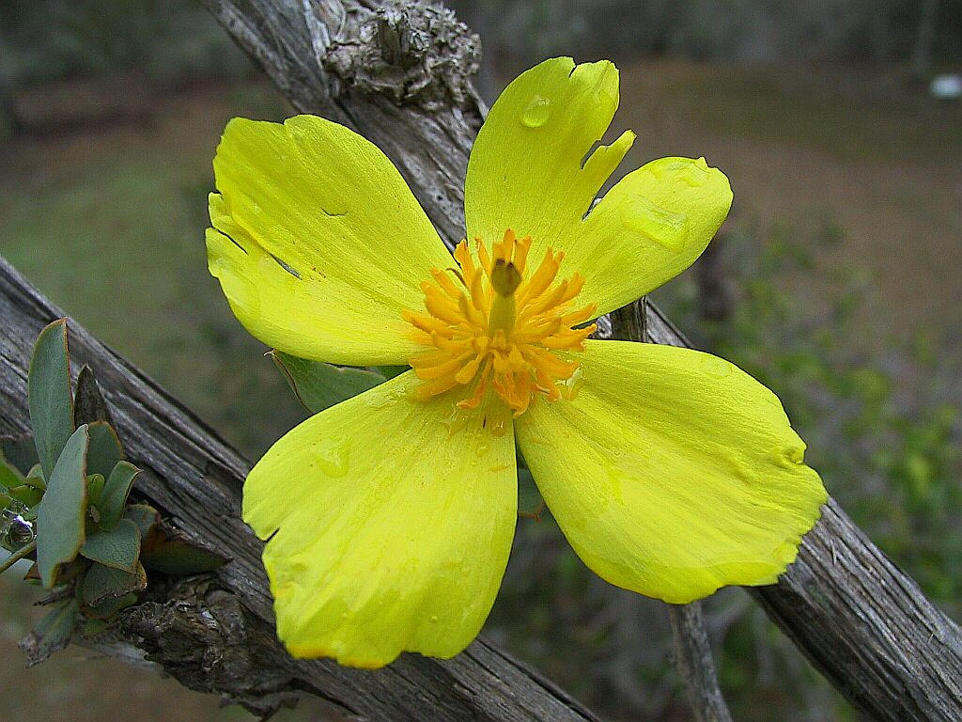
Thank you

